Slide 1











Day-4 Module Overview: Networking Basics
SOC-L1 TRAINING
09:00 AM
Learning Objectives
NETWORK VISIBILITY MAP
LIVE
Understand essential networking and identity concepts for analysts.
ACTIVE FLOWS
EVENTS/SEC
2,405
840
PC-01
Build confidence in reading real-time SOC communication flows.
INTERNET
FW-EDGE
CORE-SW
Learn to observe traffic patterns, not just memorize tool commands.
DB-01
Develop a calm, tool-agnostic mindset for incident triage.
TRAINER NOTE:
Welcome the cohort. Emphasize that networking is the "nervous system" of the SOC.
SLIDE 01 / 60

Slide 2








SOC Mindset: Observe Communication
NETWORKING BASICS
MODULE 01
WHAT IS THIS?
TRAFFIC FLOW OBSERVER
NORMAL
Network traffic is simply people and services talking to each other across digital paths.
User_PC
HTTPS (443)
Web_Svr
WHY DOES IT EXIST?
App_Svc
SQL (3306)
DB_Cluster
To understand the intent and identity behind every connection attempt.
Remote_IP
SSH (22)
Bastion
HOW SOC OBSERVES IT
We follow source → destination paths to spot anomalies in who is talking to whom.
> OBSERVING TRAFFIC PATTERNS...
[09:01:22] SRC:192.168.1.50 -> DST:10.0.0.5 PORT:443 [ALLOW]
[09:01:23] SRC:10.0.0.5 -> DST:10.0.2.20 PORT:3306 [ALLOW]
[09:01:25] SRC:203.0.113.8 -> DST:192.168.1.10 PORT:22 [DENY]
Focus: What changed, where, and why.
TRAINER NOTE:
"Observe the flows on the right. Notice how we track Source to Destination."
SLIDE 02 / 60

Slide 3






How This Module Builds SOC Confidence
NETWORKING BASICS
MODULE 01
WHAT
CONFIDENCE BUILDER VIEW
LEARNING MODE
Clear visuals and plain language to demystify complexity.
WHY
To remove the fear of networking concepts for beginners.
VISUALIZATION
Confusing Logs
Clear Insight
SOC USE
Map confusing events to simple traffic flows quickly.
UNDERSTANDING
Fear of Net
SOC Ready
Outcome: Ready for SOC L1 monitoring screens.
SKILL ACQUISITION DETECTED: +100%
TRAINER NOTE:
"This module turns scary logs into simple pictures. You will learn to see the story, not just the data."
SLIDE 03 / 60

Slide 4


OSI Model: Conceptual View
NETWORKING FUNDAMENTALS
MODULE 02
WHAT IS THIS?
OSI REFERENCE MODEL
STANDARD VIEW
A seven-layer conceptual model describing how digital systems communicate.
SOFTWARE LAYERS
7
Application
User Interface / Data
WHY DOES IT EXIST?
To separate networking responsibilities cleanly, allowing easier troubleshooting and design.
6
Presentation
Encryption / Formatting
5
Session
Connection Management
HOW SOC OBSERVES IT
4
Transport
Reliability / Flow Control
We localize connectivity issues by identifying which specific layer is failing.
HARDWARE LAYERS
3
Network
Routing / Addressing
2
Data Link
Physical Addressing (MAC)
Note: Focus on the concept, not deep engineering details.
1
Physical
Cables / Signals / Binary
TRAINER NOTE:
"Observe the stack on the right. Notice how layers separate hardware (bottom) from software (top)."
SLIDE 04 / 60

Slide 5




OSI Layers: What SOC Observes
NETWORKING FUNDAMENTALS
MODULE 02
WHAT IS THIS?
OSI VISIBILITY STACK
SOC VIEW
Each OSI layer emits different signals, helping us pinpoint where a problem (or attack) is happening.
HIGH VISIBILITY
7
Application
HTTP, DNS, SMTP
WHY DOES IT EXIST?
6
Presentation
Encryption, Formats
Layer-based thinking speeds up triage. You don't debug Wi-Fi cables for a DNS error.
5
Session
Auth Tokens
HOW SOC OBSERVES IT
We map alerts to specific layers (Application, Transport, Network) to define the scope instantly.
HIGH VISIBILITY
4
Transport
TCP Ports, UDP
HIGH VISIBILITY
3
Network
IP Addresses
Example: DNS queries live at Layer 7.
2
Data Link
MAC Addresses
TRAINER NOTE:
"Observe the highlighted layers (7, 4, 3). These are where SOC analysts spend 90% of their time."
1
Physical
Cables, Signals
SLIDE 05 / 60

Slide 6

TCP/IP Model: Conceptual Mapping
NETWORKING FUNDAMENTALS
MODULE 02
WHAT IS THIS?
TCP/IP STACK VIEW
ACTIVE MODEL
A practical four-layer stack model that defines how data moves across the internet.
WHY DOES IT EXIST?
4. APPLICATION
HTTP
DNS
SSH
It matches real-world traffic patterns better than the theoretical OSI model.
User Interface & Services
3. TRANSPORT
TCP
UDP
HOW SOC OBSERVES IT
Host-to-Host Communication
We align logs to this model to quickly identify where communication is breaking down.
2. INTERNET
IPv4
IPv6
ICMP
Addressing & Routing
1. NETWORK ACCESS
Ethernet
Wi-Fi
MAC
Physical & Data Link
Outcome: Cleaner investigation paths.
TRAINER NOTE:
"This 4-layer model is what you'll actually see in log headers. Notice how layers map to real protocols."
SLIDE 06 / 60

Slide 7
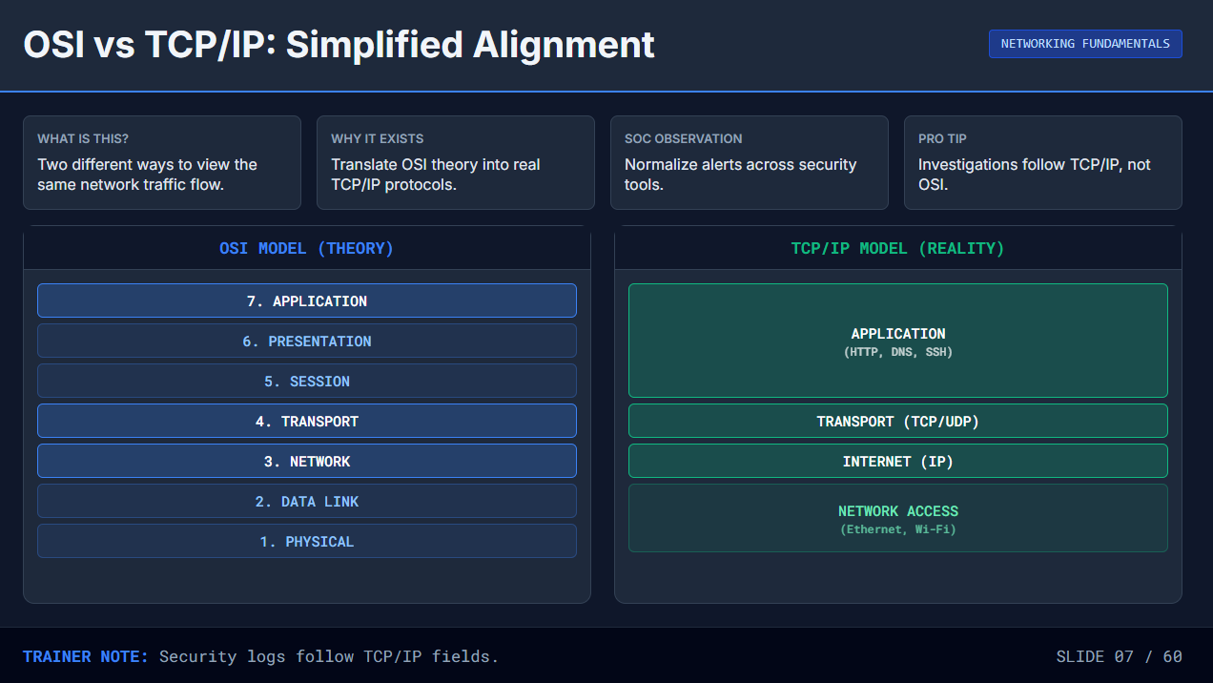

Slide 8







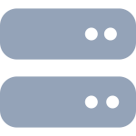




Network Architectures: On-Prem, Cloud, Hybrid
NETWORKING FUNDAMENTALS
WHAT IS THIS?
WHY IT EXISTS
SOC OBSERVATION
OUTCOME
The three main ways enterprise networks are physically and logically built.
Different business needs drive where data lives (control vs. scale).
We must know where our "cameras" (logs/sensors) are placed.
Predict traffic paths and identify blind spots quickly.
TRADITIONAL ON-PREM
PUBLIC CLOUD
HYBRID NETWORK
Firewall
VPC Logs
Tunnel Logs
VPN
HQ
Cloud
Physical Datacenter
AWS / Azure / GCP
CloudTrail
Switch/TAP
"We own the hardware. Traffic flows inside our building."
"Someone else's hardware. Visibility via API logs."
"Connected worlds. Critical choke point is the connection."
TRAINER NOTE:
"In hybrid setups, observing the VPN tunnel (the bridge) is often the most critical monitoring point."
SLIDE 08 / 60

Slide 9








Client-to-Service: Clean Flow Timeline
NETWORK VISIBILITY
SOC-L1 TRAINING
WHAT IS THIS?
WHY DOES IT EXIST?
SOC USE & OUTCOME
A structured 4-stage sequence: Request → Resolve → Connect → Exchange.
Timelines reveal exactly where a connection failed or slowed down.
Correlate user-reported delays with specific protocol stages.
Builds confident flow reasoning by isolating the root cause.
Every successful network conversation follows this predictable order.
Allows precise diagnosis rather than guessing "the network is down."
T+0.00s
T+0.05s
T+0.12s
T+0.18s
FLOW LIFECYCLE MONITOR
STATUS: COMPLETE
ID: FL-9382
REQUEST
RESOLVE
CONNECT
EXCHANGE
User initiates action
DNS Lookup
TCP Handshake
Data Transfer
(Click or Command)
Name to IP Address
(SYN / SYN-ACK)
(HTTP / SMB / SSH)
SOC OBSERVATION:
Notice how "Resolution" must happen before "Connection". A failure at step 2 prevents step 3.
SLIDE 09 / 60

Slide 10











Logical Zones: LAN, WAN, DMZ, Cloud
MODULE 03
NETWORK ARCHITECTURE
WHAT IS THIS?
ZONE TRAFFIC MAP
LIVE VIEW
Segmented communication areas separated by security controls to isolate assets.
LAN (TRUSTED)
DMZ (BUFFER)
WAN (UNTRUSTED)
WHY DOES IT EXIST?
To reduce risk exposure and limit the "blast radius" if one area is compromised.
Internal Staff, Workstations, Private Servers
Public Web Servers, Email Gateways, Proxies
The Internet, External Attackers, Remote Users
HOW SOC OBSERVES IT
We conduct zone-aware investigations, checking if traffic crossed a security boundary.
SQL (Strict)
HTTP/S (Allowed)
192.168.1.x
172.16.1.10
Any IP
192.168.10.x
172.16.1.20
Threats
Key: Did the attacker jump from DMZ to LAN?
TRAINER NOTE:
"Observe the zones. Traffic flows from Untrusted (WAN) to DMZ, but rarely directly to LAN."
SLIDE 10 / 60

Slide 11











Where SOC Sees Traffic
VISIBILITY
MODULE 03
WHAT IS THIS?
VISIBILITY COVERAGE MAP
active_monitoring
A collection of logs, mirrors, and sensors placed strategically across the network.
INTERNAL / LAN
DMZ / EDGE
CLOUD / WAN
WHY DOES IT EXIST?
Endpoint Logs
Firewall Logs
VPC Flow Logs
To provide complete coverage across all zones (LAN, DMZ, Cloud) and eliminate dark spots.
Switch Logs
IDS / IPS Alerts
CDN Logs
Internal TAPs
Proxy Logs
Email Gateway
HOW SOC OBSERVES IT
We combine views from multiple sources to build full context around an event.
Outcome: Fewer blind spots.
LOGS FLOWING
PCAP AVAILABLE
Coverage: 94%
TRAINER NOTE:
"We combine Endpoint, Firewall, and Proxy logs. No single tool sees everything."
SLIDE 11 / 60

Slide 12






Identity Markers in Communication
IP ADDRESSING & IDENTITY
MODULE 04
WHAT IS THIS?
IDENTITY TRACING VIEW
ACTIVE SESSION
The unique digital fingerprints—MAC, IP, and Ports—that identify every sender and receiver.
WHY DOES IT EXIST?
SOURCE (Client)
DEST (Server)
To answer "Who spoke to whom?" and distinguish specific services on a device.
MAC (HARDWARE)
MAC (HARDWARE)
00:1A:2B:3C:4D:5E
AA:BB:CC:DD:EE:FF
IP (LOGICAL)
HTTPS / TCP
IP (LOGICAL)
HOW SOC OBSERVES IT
192.168.1.100
203.0.113.50
We link alerts to entities to reconstruct traceable conversations across the network.
PORT (APP)
PORT (APP)
49152 (Random)
443 (Web)
MAC Address
IP Address
Port Number
Physical Device ID
Network Location
Specific Service
Goal: Pinpoint the exact device and app.
TRAINER NOTE:
"Observe the three identity layers: Hardware (MAC), Location (IP), and Service (Port)."
SLIDE 12 / 60

Slide 13

Wireshark: What and Why
NETWORK VISIBILITY
MODULE 03
WHAT IS THIS?
PACKET CAPTURE VISUALIZATION
PCAP VIEW
A deep packet inspection tool that captures raw network traffic for microscopic analysis.
No.
Time
Source
Dest
Proto
Info
WHY DOES IT EXIST?
142
10.421
192.168.1.10
203.0.113.5
TCP
49201 → 443 [SYN] Seq=0 Win=64240
To see the exact content of communication when high-level logs aren't enough.
143
10.452
203.0.113.5
192.168.1.10
TCP
443 → 49201 [SYN, ACK] Seq=0 Ack=1
144
10.453
192.168.1.10
203.0.113.5
TCP
49201 → 443 [ACK] Seq=1 Ack=1
HOW SOC OBSERVES IT
We use it sparingly for awareness and escalation, mostly during deep forensic investigations.
145
10.455
192.168.1.10
203.0.113.5
TLSv1.2
Client Hello
Frame 145: 219 bytes on wire (1752 bits)
Server Hello, Certificate, Server Hello Done
146
10.488
203.0.113.5
192.168.1.10
TLSv1.2
▶ Ethernet II, Src: Dell_a1:b2:c3, Dst: Cisco_d4:e5:f6
▶ Internet Protocol Version 4, Src: 192.168.1.10, Dst: 203.0.113.5
▶ Transmission Control Protocol, Src Port: 49201, Dst Port: 443
▼ Transport Layer Security
▼ TLSv1.2 Record Layer: Handshake Protocol: Client Hello
Note: No live capture practice here. Awareness only.
Content Type: Handshake (22)
Version: TLS 1.0 (0x0301)
TRAINER NOTE:
"This is what raw traffic looks like. It's granular, complex, and only used when logs aren't enough."
SLIDE 13 / 60

Slide 14





When SOC Uses Wireshark
NETWORK ANALYSIS
SOC-L1 TRAINING
WHAT IS THIS?
WHY DOES IT EXIST?
SOC USE & OUTCOME
Narrow, time-bound analysis of specific packet data.
Validates hypotheses quickly with raw network truth.
Sample specific flows, never capture the whole network.
Used only when high-level logs are insufficient.
Proves exactly what happened on the wire.
Delivers evidence-backed conclusions for reports.
INVESTIGATION WORKFLOW
STATUS: VALIDATING
CASE: INC-4022
Start
Action
Process
Verify
Finish
ALERT
CAPTURE
ANALYZE
VALIDATE
DOCUMENT
Suspicious activity
Record specific
Inspect payload
Confirm or deny
Attach evidence
triggered
packet sample
& headers
hypothesis
to ticket
SOC OBSERVATION:
Notice this workflow is linear and targeted. We don't just "watch traffic"—we investigate specific alerts.
SLIDE 14 / 60

Slide 15


MAC Address: Device Hardware Identity
IP ADDRESSING & IDENTITY
MODULE 04
WHAT IS THIS?
ASSET IDENTITY INSPECTOR
LAYER 2
A Layer-2 physical identifier (Media Access Control) burned into the network card.
00 : 50 : 56
C0 : 00 : 08
WHY DOES IT EXIST?
:
To ensure data frames reach the specific physical interface on a local network segment.
VENDOR OUI (3 BYTES)
NIC SPECIFIC (3 BYTES)
HOW SOC OBSERVES IT
We tie dynamic IP addresses back to persistent hardware to track specific devices.
AUTO-LOOKUP RESULTS
Target MAC:
00:50:56:C0:00:08
OUI Database:
VMware, Inc.
Note: MACs can be virtualized or spoofed.
Asset Type:
Virtual Interface
Last Seen:
Active (Local Segment)
TRAINER NOTE:
"Observe the first half. The 'OUI' tells us the manufacturer, helping us identify if it's a Dell, Apple, or Virtual Machine."
SLIDE 15 / 60

Slide 16


Introduction to IP Addressing
IP ADDRESSING & IDENTITY
MODULE 04
WHAT IS THIS?
IP FLOW VISUALIZER
ACTIVE
A unique logical address assigned to every device to allow communication across networks.
WHY DOES IT EXIST?
DATA PACKET
DESTINATION (Web)
To route traffic correctly between different networks, just like a postal address routes mail.
SOURCE (User)
192.168.1.50
10.0.0.5
HOW SOC OBSERVES IT
We attribute every network event to a specific IP entity to establish identity.
// SOC LOG VIEW: IDENTITY ATTRIBUTION
[timestamp] SRC_IP:192.168.1.50 initiated connection to DST_IP:10.0.0.5
[timestamp] Protocol: TCP | Port: 443 | Action: ALLOWED
> Identity established: User_PC -> Corporate_Web_Server
Outcome: Clear identity context for investigations.
TRAINER NOTE:
"Observe the flow. Without the IP addresses, we wouldn't know who is talking to whom."
SLIDE 16 / 60

Slide 17


IPv4 Basics: Conceptual Structure
IP ADDRESSING
MODULE 04
WHAT IS THIS?
IPv4 STRUCTURE VISUALIZER
32-BIT ADDRESS
The familiar "dotted decimal" address format used by almost every organization today.
192
168
1
100
WHY DOES IT EXIST?
It provides a unique, readable identity for devices on a network, enabling routing.
.
.
.
OCTET 1
OCTET 2
OCTET 3
OCTET 4
11000000
10101000
00000001
01100100
HOW SOC OBSERVES IT
We recognize common patterns (like 192.168.x.x) to quickly identify internal vs. external hosts.
Values range from 0 to 255 per block
FORMAT NAME
TOTAL LENGTH
Dotted Decimal Notation
4 Bytes (32 Bits)
Note: No math required. Just recognize the 4-part structure.
Valid IPv4 Address Confirmed
TRAINER NOTE:
"This is the address format you will see in 99% of your logs today. Just 4 numbers separated by dots."
SLIDE 17 / 60

Slide 18

IPv4 In Enterprise Dashboards
IP ADDRESSING & IDENTITY
MODULE 04
WHAT IS THIS?
FIREWALL TRAFFIC LOGS
LIVE VIEW
IPv4 addresses appear as either Private (Internal) or Public (Internet-facing) depending on the network zone.
09:14:22
ALLOW
192.168.1.50
LAN
→
192.168.1.10
LAN
SMB
WHY DOES IT EXIST?
09:14:25
ALLOW
172.16.20.5
DMZ
→
10.0.50.20
APP
HTTPS
Addressing rules vary by zone to manage routing, security, and scarcity of public IP addresses.
09:14:30
NAT
10.0.0.150
LAN
→
203.0.113.88
WAN
HTTP
09:14:35
DENY
198.51.100.2
WAN
→
203.0.113.10
FW
SSH
HOW SOC OBSERVES IT
We correlate Private IPs with NAT logs to identify the true internal source of external traffic.
ANALYST NOTE: Notice how traffic flows between zones. Private IPs (192.x, 10.x) stay internal. Public IPs (203.x) are on the internet side.
Outcome: Accurate attribution of source identity.
TRAINER NOTE:
"Look at the log entries. Can you spot which IP addresses are Private (Internal) and which are Public (Internet)?"
SLIDE 18 / 60

Slide 19

IPv6 Basics: Conceptual Structure
IP ADDRESSING & IDENTITY
MODULE 04
WHAT IS THIS?
IPV6 STRUCTURE INSPECTOR
128-BIT
A 128-bit address using hexadecimal numbers (0-9, A-F) separated by colons (:).
FULL EXPANDED ADDRESS
WHY DOES IT EXIST?
2001
:
0db8
:
85a3
:
0000
:
0000
:
8a2e
:
0370
:
7334
IPv4 ran out of space. IPv6 provides infinite scale for modern cloud and IoT networks.
Prefix (Network)
Subnet
Interface ID (Host)
HOW SOC OBSERVES IT
We parse longer, complex strings in logs. Don't fear the length; look for the patterns.
HEXADECIMAL
GROUPS
0-9, A-F
8 groups
Base-16 System
4 hex digits each
Simplified (Zero Compression)
2001
:
db8
:
85a3
::
8a2e...
Note: No math required. Just recognize the format.
Double colon (::) replaces consecutive zeros once.
TRAINER NOTE:
"Observe the length and the letters A-F. This is how modern devices identify themselves."
SLIDE 19 / 60

Slide 20
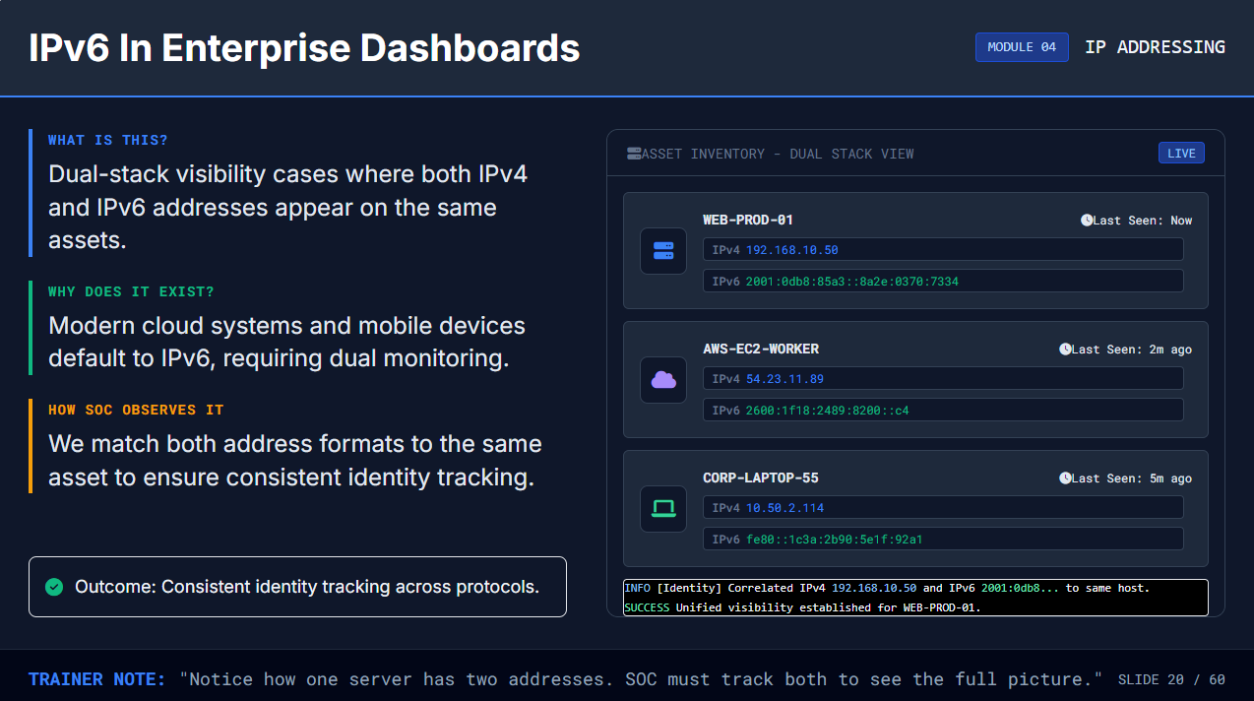

Slide 21
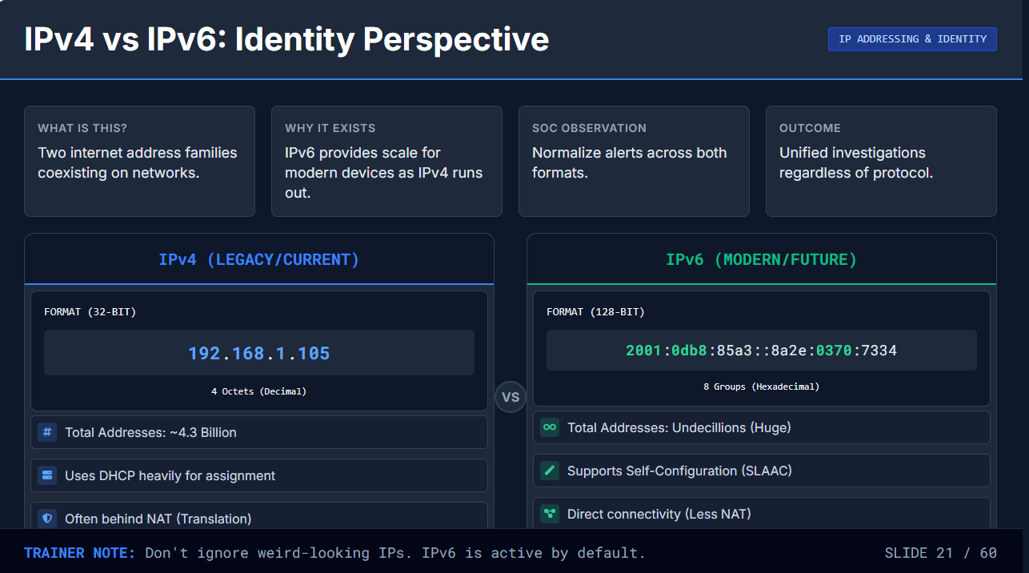

Slide 22

SOC Log Fields for Identity
IP ADDRESSING & IDENTITY
MODULE 04
WHAT IS THIS?
RAW EVENT LOG VIEWER
PARSED
Key identifiers in logs: Source/Destination IPs, Ports, MAC addresses, and Interface IDs.
WHY DOES IT EXIST?
These fields allow analysts to reconstruct who spoke to whom, when, and how.
event_type="firewall_allow" timestamp="2023-10-24T08:42:15Z"
HOW SOC OBSERVES IT
src_ip=
192.168.10.55
src_port=
49231
dst_ip=
10.20.5.100
dst_port=
action=ALLOW interface=eth0
We filter by these fields to pivot between events and build a reliable timeline.
443
proto=TCP src_mac=
00:1A:2B:3C:4D:5E
SOURCE IDENTITY
DESTINATION TARGET
PHYSICAL DEVICE
SERVICE CONTEXT
192.168.10.55
10.20.5.100
00:1A:2B...
Who initiated the conversation (Internal Workstation)
TCP/443
Who received the request (Internal Web Server)
Hardware address confirms device identity
Port 443 indicates secure HTTPS web traffic
Outcome: Faster triage decisions.
TRAINER NOTE:
"Notice how we use these specific fields to reconstruct the entire story of 'Who talked to whom'."
SLIDE 22 / 60

Slide 23



Network Addressing: Concept Only
NET ADDRESSING
MODULE 05
WHAT IS THIS?
ADDRESS STRUCTURE VISUALIZER
CONCEPT VIEW
An IP address is split into two logical parts: one identifies the network, the other identifies the specific device (host).
NETWORK ID (Street Name)
HOST ID (House Number)
WHY DOES IT EXIST?
192
.
168
.
1
.
100
To organize millions of devices efficiently, like street names (network) and house numbers (host).
HOW SOC OBSERVES IT
SHARED PREFIX
|
We quickly recognize boundaries to tell if traffic is staying "on the same street" or leaving the neighborhood.
UNIQUE SUFFIX
Common to all devices in this zone
Specific to one machine
"SOC sees 192.168.1.50 talking to 192.168.1.100 as local traffic."
Note: No subnet math required. Just spot the pattern.
TRAINER NOTE:
"Observe the color split. The blue part is the 'Street', the green part is the 'House'."
SLIDE 23 / 60

Slide 24
CIDR: Conceptual Grouping
NETWORKING CONCEPTS
MODULE 05
WHAT IS THIS?
ADDRESS RANGE VISUALIZATION
DEFINED
A standardized method to define IP address ranges using compact notation.
192.168.1.0
/24
WHY DOES IT EXIST?
To provide a flexible, efficient way to group IPs without listing every single address.
NETWORK ID
RANGE SIZE
HOW SOC OBSERVES IT
We use CIDR blocks to create simple filters for entire network segments.
192.168.1.0
256 Addresses
The Group Name
192.168.1.0 - .255
SOC FILTER EXAMPLE
user@soc:~$
search src_ip IN 192.168.1.0/24
Note: Focus on the concept of "ranges", not the math.
Match found: 192.168.1.55
Match found: 192.168.1.102
Match found: 192.168.1.200
TRAINER NOTE:
"The /24 tells us we are looking at the whole '192.168.1' neighborhood, not just one house."
SLIDE 24 / 60

Slide 25







Private vs Public IP: Clear Differences
NETWORK CONCEPTS
WHAT IS THIS?
WHY IT EXISTS
SOC OBSERVATION
OUTCOME
Internal-only addresses vs Internet-routable addresses.
To conserve IPv4 space and provide internal containment.
Prioritize investigation based on internal/external scope.
Make correct escalation decisions based on exposure.
PRIVATE IP (INTERNAL)
PUBLIC IP (INTERNET)
10.0.0.0 - 10.255.255.255
Class A
8.8.8.8 (Google DNS)
Any
Used for large enterprise networks. Not routable on internet.
Examples: 1.1.1.1, 142.250.x.x. Reachable from anywhere.
172.16.0.0 - 172.31.255.255
Class B
Direct Exposure
Mid-sized networks. Often used for AWS/Cloud VPCs.
Traffic to/from these IPs crosses the internet boundary.
192.168.0.0 - 192.168.255.255
Class C
SOC LOGIC CHECK:
Small office / Home networks. Most common local range.
Src: 10.x.x.x → Dest: 192.168.x.x = Lateral (Internal)
TRAINER NOTE:
Src: 10.x.x.x → Dest: 8.8.8.8 = Outbound (Internet)
"If you see a 192.168.x.x address attacking a 10.x.x.x address, the threat is INSIDE the building."
SLIDE 25 / 60
Safe behind NAT / Firewall
Globally Unique & Routable

Slide 26



APIPA: Automatic Private Addressing
NETWORKING CONCEPTS
MODULE 05
WHAT IS THIS?
DHCP FAILURE SIMULATION
CONNECTIVITY ERROR
A self-assigned IP address (169.254.x.x) given by the OS when no DHCP server is found.
WHY IT HAPPENS
The device shouted for an IP address but received No DHCP Response from the network.
Workstation
DHCP Server
169.254.0.15
UNREACHABLE
[Self-Assigned]
[No Response]
REQUEST TIMEOUT
SOC OBSERVATION
Seeing 169.254.x.x explains why a host cannot talk to the internet or corporate WAN.
SOC ALERT: LOCAL LINK ONLY
Host cannot route traffic outside the local segment. Internet access and corporate resources are unavailable.
APIPA RANGE
SUBNET MASK
169.254.0.1 - 169.254.255.254
255.255.0.0 (/16)
Outcome: Reduce false alarms—it's a config issue, not an attack.
TRAINER NOTE:
"Observe the IP 169.254... This specific range means DHCP failed. It's not a hacker, it's a broken connection."
SLIDE 26 / 60

Slide 27






NAT: Why Enterprises Use It
MODULE 05
NETWORK ADDRESSING
WHAT IS THIS?
NAT TRANSLATION MONITOR
ACTIVE
Network Address Translation (NAT) modifies IP headers to replace internal addresses with public ones.
INTERNAL (LAN)
INTERNET (WAN)
WHY DOES IT EXIST?
192.168.1.50
To conserve limited public IPv4 addresses and hide internal network topology from the internet.
NAT GATEWAY
192.168.1.51
Mapping...
203.0.113.10
(Public IP)
HOW SOC OBSERVES IT
We map the real internal identity to the translated public identity to trace activity accurately.
INTERNAL SOURCE
TRANSLATED SOURCE
DESTINATION
192.168.1.50:4521
203.0.113.10:10452
8.8.8.8:53
192.168.1.51:8080
203.0.113.10:80
1.1.1.1:443
Outcome: Accurate attribution of source.
TRAINER NOTE:
"Observe how the private IP (192.168.x) becomes the public IP (203.0.x) as it leaves."
SLIDE 27 / 60

Slide 28



NAT Effects on SOC Visibility
NETWORK CONCEPTS
MODULE 05
WHAT IS THIS?
NAT TRANSLATION VIEWER
LIVE
Network Address Translation creates many-to-one or one-to-one IP mappings.
INTERNAL ZONE (PRE-NAT)
WHY DOES IT EXIST?
User_PC
Original Source
It obscures original internal sources from the external internet.
192.168.1.50
FIREWALL
SOC VISIBILITY CHALLENGE
NAT ACTIVE
External logs see only the NAT IP, hiding the true internal endpoint.
EXTERNAL ZONE (POST-NAT)
Translated Source
Internet
203.0.113.10
> FIREWALL TRANSLATION LOGS
RECORDING
Outcome: Trustworthy source tracing.
[10:42:01]
SRC:
192.168.1.50
->
XLATE:
203.0.113.10
->
DST:
8.8.8.8
[10:42:05]
SRC:
192.168.1.51
->
XLATE:
203.0.113.10
->
DST:
1.1.1.1
TRAINER NOTE:
"Notice how 192.168.1.50 becomes 203.0.113.10 outside. Logs must be correlated here."
SLIDE 28 / 60

Slide 29











Subnetting: Conceptual Grouping Only
NETWORK CONCEPTS
MODULE 05
WHAT IS THIS?
NETWORK SEGMENTATION VIEW
TOPOLOGY
Splitting a large network into smaller, logical segments for better organization.
SINGLE LARGE NETWORK (FLAT)
WHY DOES IT EXIST?
To limit broadcast traffic scope and improve security boundaries.
NO BOUNDARIES • HIGH NOISE
HOW SOC OBSERVES IT
SEGMENTED NETWORK (SUBNETTED)
We identify segment boundaries to detect unauthorized lateral movement.
HR DEPT
IT OPS
GUEST WIFI
BOUNDARY
BOUNDARY
192.168.1.x
192.168.2.x
192.168.3.x
TRAFFIC ISOLATED • REDUCED SCOPE
Note: Understanding boundaries is key; no math required.
TRAINER NOTE:
"Observe how segmentation creates clear 'lanes'. SOC monitors the boundaries between these lanes."
SLIDE 29 / 60

Slide 30



Supernetting: Conceptual Aggregation
MODULE 05
NETWORK ADDRESSING
WHAT IS THIS?
ROUTE AGGREGATION VISUALIZER
SIMULATION
Combining multiple smaller consecutive network ranges into a single larger route summary.
192.168.0.0/24
Sales Dept
WHY DOES IT EXIST?
192.168.1.0/24
HR Dept
To simplify routing tables and make network representation more efficient.
192.168.2.0/24
IT Dept
192.168.3.0/24
Admin Dept
HOW SOC OBSERVES IT
We filter broader ranges (like /22 instead of four /24s) to catch activity across related subnets.
AGGREGATING ROUTES
Note: This is just a conceptual grouping. No complex math required.
192.168.0.0/22
Includes all 4 networks (0.0 - 3.255)
SOC Filter: src_net="192.168.0.0/22"
TRAINER NOTE:
"Observe how 4 separate /24 networks combine into one /22 supernet. It's just simplification."
SLIDE 30 / 60

Slide 31









Address Planning: Investigation Benefits
NETWORK CONCEPTS
MODULE 05
WHAT IS THIS?
IP ALLOCATION MAP
DOCUMENTED
Using predictable, documented IP ranges for specific departments or functions.
10.10.0.0/16
Corporate Staff (HQ)
TRUSTED
WHY DOES IT EXIST?
USERS
To allow faster alert triage by knowing exactly who owns an IP range.
10.20.0.0/16
Datacenter Production
CRITICAL
SERVERS
HOW SOC OBSERVES IT
We map suspicious IP addresses directly to their owners without guessing.
172.16.0.0/20
Visitor Wi-Fi
UNTRUSTED
GUEST
192.168.100.0/24
Engineering Sandbox
SANDBOX
DEV LAB
Outcome: Reduced investigation time.
TRIAGE SCENARIO:
Alert from 172.16.5.22? Check "GUEST" rules first.
TRAINER NOTE:
"If you see an alert from 10.20.x.x, you instantly know it's a critical server, not a guest."
SLIDE 31 / 60

Slide 32




CIDR in Filters: Practical SOC Use
NETWORK ADDRESSING
MODULE 05
WHAT IS THIS?
SIEM QUERY BUILDER
LIVE
Using CIDR notation (e.g., /24, /16) to search whole network ranges instantly.
FILTER:
src_ip =
192.168.1.0/24
AND action="DENIED"
RUN
WHY DOES IT EXIST?
To catch related activity across an entire subnet without typing every single IP.
SCOPE VISUALIZATION
HOW SOC OBSERVES IT
CIDR RANGE
MATCHES
192.168.1.0/24
254 HOSTS
We save clean CIDR filters to create repeatable triage workflows.
Includes: 192.168.1.1 — 192.168.1.254
TIME
SOURCE IP
DESTINATION
ACTION
09:41:05
192.168.1.45
10.0.5.22
DENIED
09:41:08
192.168.1.102
10.0.5.22
DENIED
Outcome: Find all hosts in a subnet instantly.
09:41:12
192.168.1.15
8.8.8.8
DENIED
09:41:15
192.168.1.200
10.0.5.80
DENIED
TRAINER NOTE:
"Observe how one simple filter '/24' instantly finds logs from every machine in that department."
SLIDE 32 / 60

Slide 33



What is VPN: Concept and Purpose
MODULE 06
TRAFFIC COMPONENTS
WHAT IS THIS?
SECURE TUNNEL VISUALIZER
CONNECTED
An encrypted tunnel that safely carries private data over untrusted public networks.
Internet (Untrusted)
WHY DOES IT EXIST?
Encrypted Tunnel
VPN Gateway
To provide confidential remote access for employees working outside the secure office network.
Decrypt Point
Remote User
Internal App
Public IP
Private IP
HOW SOC OBSERVES IT
// VPN SESSION LOGS
We monitor session health, duration, and geography to verify remote identities.
[10:42:01] CONNECT User:jdoe from IP:203.0.113.45 (Home)
[10:42:02] AUTH 2FA Challenge: Success
[10:42:03] TUNNEL ESP Tunnel Established (AES-256)
[10:42:05] ACCESS jdoe -> Internal_FileSvr (10.0.1.50) [ALLOWED]
Outcome: Verified, secure remote identities.
TRAINER NOTE:
"Observe the blue encrypted packets in the tunnel. To the internet, this data is unreadable."
SLIDE 33 / 60

Slide 34




SOC Visibility: VPN Sessions
TRAFFIC COMPONENTS
MODULE 06
WHAT IS THIS?
VPN SESSION MONITOR
LIVE VIEW
VPN logs reveal user logins, session durations, and origin locations.
42
USA, DE
2
WHY DOES IT EXIST?
ACTIVE SESSIONS
TOP ORIGINS
RISKY LOGINS
To spot risky access patterns like impossible travel or unusual hours.
USER
SOURCE IP
ORIGIN
DURATION
SESSIONS
STATUS
HOW SOC OBSERVES IT
jsmith
203.0.113.45
USA
04:12:30
1
ACTIVE
We check geolocation and concurrency for signs of compromised credentials.
adoe
198.51.100.22
DEU
00:45:10
1
ACTIVE
mlee
192.0.2.88
CHN
00:02:15
2
FLAGGED
kpatel
203.0.113.99
USA
01:20:00
1
ACTIVE
root_admin
45.33.22.11
UNK
00:00:05
5
ALERT
Outcome: Early anomaly detection.
> MONITORING SESSION CONCURRENCY...
[14:22:05] User 'jsmith' session validated. Geo: Chicago, IL.
[14:25:30] WARNING: User 'mlee' logged in from 2 distinct geos within 5 mins (Impossible Travel).
TRAINER NOTE:
"Observe the 'Risky' and 'Critical' rows. Why is 'Impossible Travel' or 5 concurrent sessions alarming?"
[14:26:12] CRITICAL: 'root_admin' rapid login failures detected from non-standard IP range.
SLIDE 34 / 60

Slide 35









Proxy vs Reverse Proxy: Concepts
TRAFFIC COMPONENTS
WHAT IS THIS?
WHY IT EXISTS
SOC OBSERVATION
OUTCOME
Intermediaries: Client proxy vs Server proxy.
Control points for filtering and protection.
Review request metadata logs for usage.
Safer external exposure and usage.
FORWARD PROXY (Client-Side)
REVERSE PROXY (Server-Side)
Internal Client
Proxy Server
Internet
Internet Client
Reverse Proxy
Internal Server
KEY FUNCTION
KEY FUNCTION
Protects clients & filters outbound traffic.
Protects servers & balances inbound traffic.
TRAINER NOTE:
"Forward proxy acts on behalf of clients (you); Reverse proxy acts on behalf of servers (them)."
SLIDE 35 / 60

Slide 36
SOC Visibility: Proxy Logs
TRAFFIC COMPONENTS
MODULE 06
WHAT IS THIS?
WEB PROXY ACTIVITY LOGS
LIVE FEED
A record of every web request (URL) made by internal users or devices to the internet.
TIME
USER
URL / DOMAIN
CATEGORY
ACTION
WHY DOES IT EXIST?
10:45:12
jsmith
docs.microsoft.com
Tech/Reference
ALLOWED
To understand user intent, enforce web policies, and categorize external destinations.
10:45:15
jsmith
github.com/azure
Dev Tools
ALLOWED
10:48:33
mdoe
suspicious-dl.xyz
Malware/Risk
BLOCKED
HOW SOC OBSERVES IT
We review log fields like URL, Category, and Action (Blocked/Allowed) to detect misuse trends.
10:48:34
mdoe
192.0.2.10/payload.exe
Direct IP
BLOCKED
10:52:10
ksmith
salesforce.com
Business App
ALLOWED
10:53:22
ksmith
linkedin.com/feed
Social Net
ALLOWED
Outcome: Informed response actions based on usage context.
FIELD BREAKDOWN:
URL / DOMAIN
CATEGORY
ACTION
The exact destination requested.
Classifies site type (e.g., Gambling, Tech).
Did the proxy let it through?
TRAINER NOTE:
"Observe the logs. Notice the blocked attempt to a malware site. The 'Category' field is key for context."
SLIDE 36 / 60

Slide 37





Load Balancer: Concept
TRAFFIC COMPONENTS
MODULE 06
WHAT IS THIS?
LB CLUSTER STATUS - VIP: 192.0.2.20
ACTIVE
A device that distributes incoming network traffic across multiple backend servers or instances.
Clients
HTTPS Requests
Load Balancer
Route A
HEALTHY
Svr_01
WHY DOES IT EXIST?
Ensures reliability, high availability, and allows applications to scale horizontally.
Route B
Svr_02
HEALTHY
Blocked
DOWN
Svr_03
HOW SOC OBSERVES IT
We tie incoming client requests to specific backend server destinations.
[14:02:01] LB_Algorithm: Round-Robin
[14:02:02] ReqID:8821 -> Routed to Svr_01 (10.0.1.5)
[14:02:03] ReqID:8822 -> Routed to Svr_02 (10.0.1.6)
[14:02:04] HEALTH_CHECK: Svr_03 (10.0.1.7) connection refused. Removed from pool.
Outcome: Accurate impact assessment.
TRAINER NOTE:
"Observe how the single entry point (VIP) splits traffic to multiple servers based on health."
SLIDE 37 / 60

Slide 38





SOC Visibility: Load-Balanced Traffic
TRAFFIC ANALYSIS
SOC-L1 TRAINING
WHAT IS THIS?
WHY DOES IT EXIST?
SOC USE & OUTCOME
Traffic distribution with health checks and routes.
Explains intermittent errors users might report.
Correlate user errors with backend health logs.
Ensures requests only reach operational servers.
Isolates failure to specific backend nodes.
Clearer incident scope and faster resolution.
T+0.00s
T+0.02s
T+0.03s
T+0.05s
T+0.08s
LB TRAFFIC FLOW
HEALTH: OK
LB-01
CLIENT REQ
LOAD BALANCER
HEALTH CHECK
ROUTE
RESPONSE
User sends request
Receives traffic
Verify backend
Forward to
Server replies
to VIP Address
& checks policy
is available
Healthy Backend
via LB to Client
SOC OBSERVATION:
Logs often show the Load Balancer IP as the "Client" in backend server logs.
SLIDE 38 / 60

Slide 39



CDN: Concept and Value
TRAFFIC & ACCESS
MODULE 06
WHAT IS THIS?
GLOBAL CONTENT DELIVERY NETWORK
ACTIVE
A distributed network of servers delivering content based on user location.
ORIGIN
EDGE CACHE
WHY DOES IT EXIST?
To improve speed by caching content closer to users and offloading the origin server.
HOW SOC OBSERVES IT
EDGE (EU)
We identify provider domains in logs to distinguish legitimate CDN traffic from anomalies.
ORIGIN (US)
EDGE (ASIA)
EDGE (AF)
Outcome: Correct attribution decisions.
USER REQUEST: GET /image.png
HIT (CACHE)
15ms
TRAINER NOTE:
"Notice how users connect to the blue Edge servers, not the red Origin. This is why you see CDN IPs."
SLIDE 39 / 60

Slide 40



SOC Visibility: CDN Traffic
TRAFFIC ANALYSIS
SOC-L1 TRAINING
WHAT & WHY?
SOC USE
OUTCOME
Observing DNS redirects and edge server responses.
Identify authorized CDN providers in logs.
Proper investigation routing based on CDN identification.
Traffic often terminates at CDN, rarely hitting origin.
Differentiate CDN traffic from direct server attacks.
T+0.01s
T+0.04s
T+0.08s
Optional
CDN REQUEST LIFECYCLE
CACHE: HIT
PROV: CLOUDFLARE
DNS QUERY
CNAME → CDN
EDGE RESPONSE
ORIGIN FETCH
Client requests
Redirect to
Cached content
Only if cache miss
www.example.com
cdn.provider.net
delivered from Edge
(Back to Origin)
SOC OBSERVATION:
Most user traffic ends at step 3. Seeing traffic go to Step 4 (Origin) might indicate cache bypass attacks.
SLIDE 40 / 60

Slide 41









Lab Orientation: Safe Observation First
MODULE 07
HANDS-ON LABS
LAB OBJECTIVE
LAB ENVIRONMENT OVERVIEW
ISOLATED
SAFE MODE
Learn to identify network behaviors by observing standard outputs, not by launching attacks.
OBSERVATION CHECKLIST
1. OBSERVE
2. ACTION
Visual labs with zero exploitation
Look at the initial state. What is the IP? What is the route? Establish a baseline.
Execute a standard command (ping, ipconfig, nslookup). No hacker tools required.
Learn by observing outcomes directly
Map command outputs to dashboards
3. CHANGE
4. VERIFY
SAFETY PROTOCOL
Note what changed visually in the output or dashboard. Connect cause and effect.
Confirm the result matches SOC expectations. Is the traffic flow visible?
All labs are performed in isolated environments.
Reversible changes only. No production impact.
TRAINER NOTE:
"We don't need to break things to understand them. We just need to look closely at how they work."
SLIDE 41 / 60

Slide 42
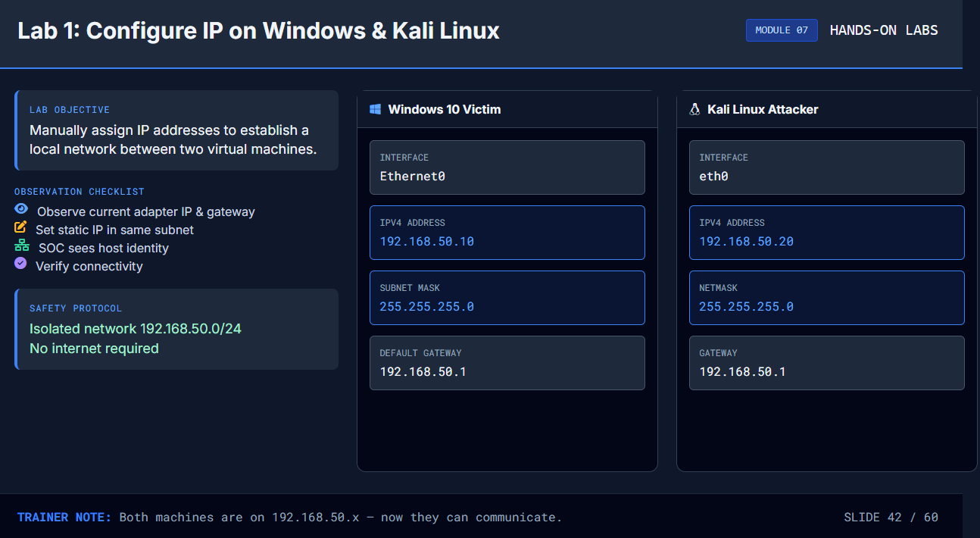

Slide 43






Lab 2: Ensure Same Network & Test Ping
MODULE 07
HANDS-ON LABS
LAB OBJECTIVE
KALI LINUX TERMINAL
CONNECTED
Verify that two machines are on the same subnet and can communicate using ICMP (Ping).
OBSERVATION CHECKLIST
Observe: Both IPs share the network prefix (e.g., 192.168.1.x)
KALI (SRC)
WIN10 (DST)
192.168.1.50
192.168.1.10
Change: Send ICMP Echo Request (Ping)
Verify: Receive "Reply from..." with time < 1ms
kali@soc-lab:~$
ping -c 4 192.168.1.10
PING 192.168.1.10 (192.168.1.10) 56(84) bytes of data.
64 bytes from 192.168.1.10: icmp_seq=1 ttl=128 time=0.482 ms
✔ REPLY
64 bytes from 192.168.1.10: icmp_seq=2 ttl=128 time=0.512 ms
✔ REPLY
64 bytes from 192.168.1.10: icmp_seq=3 ttl=128 time=0.495 ms
✔ REPLY
SOC CONTEXT
--- 192.168.1.10 ping statistics ---
Ping is the simplest way to check visibility. If Ping works, Layer 3 routing is correct.
4 packets transmitted, 4 received, 0% packet loss, time 3005ms
kali@soc-lab:~$
_
TRAINER NOTE:
"Observe the 'time=' value. It's under 1ms because they are on the same local network. If it failed, we'd check the IP range."
SLIDE 43 / 60

Slide 44







Lab 3: View IP Information
MODULE 07
HANDS-ON LABS
LAB OBJECTIVE
HOST TERMINAL OUTPUTS
WINDOWS
LINUX
Extract key identity markers (IP address, MAC address, Gateway) directly from the host operating system.
Command Prompt
C:\Users\Analyst>
ipconfig /all
OBSERVATION CHECKLIST
Ethernet adapter Ethernet0:
Windows: Run ipconfig /all
Description . . . . . . . . . . : Intel(R) 82574L Gigabit Connection
Physical Address. . . . . . . . :
00-0C-29-AB-CD-EF
Linux: Run ip addr show
IPv4 Address. . . . . . . . . . :
192.168.10.105(Preferred)
Subnet Mask . . . . . . . . . . : 255.255.255.0
Locate the IPv4 Address
Default Gateway . . . . . . . . : 192.168.10.1
Locate the MAC Address
Kali Terminal
analyst@kali:~$
ip addr show eth0
2: eth0: <BROADCAST,MULTICAST,UP,LOWER_UP> mtu 1500...
link/ether
00:0c:29:68:22:56
brd ff:ff:ff:ff:ff:ff
inet
192.168.10.106/24
brd 192.168.10.255 scope global eth0
SAFETY PROTOCOL
valid_lft forever preferred_lft forever
These are standard read-only commands. Zero impact on system configuration.
TRAINER NOTE:
"Notice the difference. Windows says 'Physical Address', Linux says 'link/ether'. But both tell us the hardware identity."
SLIDE 44 / 60

Slide 45






Lab 4: Observe Routes
MODULE 07
HANDS-ON LABS
LAB OBJECTIVE
WINDOWS COMMAND PROMPT
ROUTING TABLE
View the routing table to understand how your machine decides where to send traffic.
C:\Users\Analyst>
route print -4
=========================================================================== Interface List 14...00 0c 29 3e 5a 8b ......Intel(R) 82574L Gigabit Network Connection =========================================================================== IPv4 Route Table =========================================================================== Active Routes: Network Destination Netmask Gateway Interface Metric 0.0.0.0 0.0.0.0 192.168.1.1 192.168.1.105 25 127.0.0.0 255.0.0.0 On-link 127.0.0.1 331 192.168.1.0 255.255.255.0 On-link 192.168.1.105 281 192.168.1.105 255.255.255.255 On-link 192.168.1.105 281 255.255.255.255 255.255.255.255 On-link 127.0.0.1 331 ===========================================================================
OBSERVATION CHECKLIST
C:\Users\Analyst>
_
Observe: The "Active Routes" list and the "Gateway" address.
Action: Run route print (Windows) or ip route (Linux).
Verify: Identify the default route (0.0.0.0) that handles internet traffic.
Next Hop
Default
SOC RELEVANCE
Routes explain why traffic goes to a firewall vs. internal server. Critical for tracing attacks.
This PC
Gateway (Router)
Internet
192.168.1.105
192.168.1.1
0.0.0.0/0
TRAINER NOTE:
"See the 0.0.0.0 entry? That is the 'Default Route'. It means 'send everything else to the Gateway'."
SLIDE 45 / 60

Slide 46


Lab 5: Build Small Network Using Docker
MODULE 07
HANDS-ON LABS
LAB OBJECTIVE
DOCKER NETWORK SIMULATION
net: soc-lab-net
subnet: 172.18.0.0/16
Observe how creating a Docker network establishes an isolated communication environment.
student@soc-lab:~$
docker network create soc-lab-net
c4f9a2e3b1d8... (Network ID)
OBSERVATION CHECKLIST
student@soc-lab:~$
docker run -d --net soc-lab-net --name host-1 alpine sleep 3600
Observe: A new isolated virtual network is created.
student@soc-lab:~$
docker run -d --net soc-lab-net --name host-2 alpine sleep 3600
Change: Start multiple containers attached to this network.
LOGICAL TOPOLOGY VIEW
SOC View: Each container gets a unique internal IP.
Docker_Network_172.18.0.0/16
Verify: Ping works between containers within the network.
Gateway
172.18.0.1
SAFETY PROTOCOL
Docker networks are isolated from the host LAN.
No external traffic exposure risks.
Host-1
172.18.0.2
TRAINER NOTE:
"Observe what you see. We created a private network inside the host. Containers get IPs just like real servers."
SLIDE 46 / 60
ICMP Ping
Host-2
172.18.0.3

Slide 47



Lab 06: Docker Network Communication
MODULE 07
HANDS-ON LABS
LAB OBJECTIVE
DOCKER NETWORK TOPOLOGY
DRIVER: BRIDGE
ACTIVE
Observe how isolated containers communicate over a private bridge network using internal IPs.
DOCKER BRIDGE NETWORK (172.18.0.0/16)
OBSERVATION CHECKLIST
Observe: Isolated 'bridge' network creation (172.18.0.0/16).
ICMP (PING)
web-01
db-01
172.18.0.2
172.18.0.3
Change: Start two containers (Web & DB) in the network.
SOC View: Unique internal IPs assigned automatically.
root@web-01:/#
ping -c 2 db-01
Verify: Successful ping between containers.
PING db-01 (172.18.0.3) 56(84) bytes of data.
64 bytes from db-01.docker_net (172.18.0.3): seq=1 ttl=64 time=0.041 ms
64 bytes from db-01.docker_net (172.18.0.3): seq=2 ttl=64 time=0.038 ms
SAFETY PROTOCOL
root@web-01:/#
_
Traffic is contained within the Docker bridge.
No routing to the host LAN or Internet required.
TRAINER NOTE:
"Notice how containers get their own private IP range. To the SOC, this looks like a mini-network inside the host."
SLIDE 47 / 60

Slide 48





Lab 7: DNS Resolution Observation
MODULE 07
HANDS-ON LABS
LAB OBJECTIVE
TERMINAL - ANALYST WORKSTATION
CMD.EXE
DNS-TOOLS
Observe the Name-to-IP mapping process using standard lookup tools.
C:\Users\Analyst>
nslookup google.com
Server:
UnKnown
OBSERVATION CHECKLIST
Address:
192.168.1.1
Observe: Name to IP mapping process
Change: Query public names (e.g., google.com)
Non-authoritative answer:
SOC View: Resolver logs show the query request
Name:
google.com
Verify: Returned addresses are consistent
Addresses:
2607:f8b0:4009:80b::200e
142.250.190.46
SOC OBSERVATION
C:\Users\Analyst>
The "Query" (yellow) is what the user asked for. The "Answer" (blue box) is what the network returned. SOC logs capture both to build a history of visited sites.
_
SAFETY PROTOCOL
Standard lookup tools only (nslookup/dig).
Passive observation. No scanning.
TRAINER NOTE:
"Observe the 'Non-authoritative answer'. This means our local DNS resolver had to go ask the internet for this information."
SLIDE 48 / 60

Slide 49



Lab 8: Identify CDN Providers via DNS
MODULE 07
HANDS-ON LABS
LAB OBJECTIVE
TERMINAL: ANALYST WORKSTATION
DNS QUERY
Use DNS queries to look behind a domain name and identify if a Content Delivery Network (CDN) is being used.
analyst@soc-lab:~$
nslookup www.global-shop.com
Server: 8.8.8.8
Address: 8.8.8.8#53
OBSERVATION CHECKLIST
Look for CNAME records (Aliases) in the output.
Non-authoritative answer:
Identify provider suffixes (e.g., akamai.net, cloudfront.net).
Name: www.global-shop.com
Address: 104.18.22.10
Confirm the final IP belongs to the CDN edge, not the origin.
Aliases:
www.global-shop.com.cdn.cloudflare.net
VISUALIZING THE RESOLUTION PATH
User Query
www.global-shop.com
.cdn.cloudflare.net
104.18.22.10
SAFETY PROTOCOL
Standard public DNS resolution only. No port scanning or active probing.
CNAME (Alias)
CDN Edge IP
Browser
Public Domain
TRAINER NOTE:
"Notice the 'Aliases' line. This tells the SOC that traffic is going to Cloudflare, not directly to the company's private server."
SLIDE 49 / 60

Slide 50


Lab 9: Access Open FTP Server
MODULE 07
HANDS-ON LABS
LAB OBJECTIVE
FTP SESSION: ftp.lab.local
CONNECTED
Connect to a safe, read-only FTP server to observe plain-text file transfer behavior.
analyst@soc-workstation:~$
ftp 192.168.10.50
Connected to 192.168.10.50. 220 (vsFTPd 3.0.3) Name (192.168.10.50:analyst): anonymous 331 Please specify the password. Password:
230 Login successful.
Remote system type is UNIX. Using binary mode to transfer files.
OBSERVATION CHECKLIST
Observe: Successful login banner (230) and directory listing output.
ftp>
ls
200 PORT command successful. Consider using PASV. 150 Here comes the directory listing. -rw-r--r-- 1 ftp ftp 451 Jan 15 08:00 welcome.msg drwxr-xr-x 2 ftp ftp 4096 Jan 15 09:30 pub
226 Directory send OK.
Change: None. Simply browse directory structure using standard commands.
ftp>
cd pub
SOC View: Notice lack of encryption. Credentials sent in clear text (port 21).
250 Directory successfully changed.
ftp>
_
SAFETY PROTOCOL
Connecting to internal lab FTP only.
Do not upload sensitive data. Read-only access.
TRAINER NOTE:
"Notice the status codes (220, 230, 226). In a packet capture, we would see 'anonymous' clearly visible."
SLIDE 50 / 60

Slide 51

Lab 10: FTP Upload/Download Practice
MODULE 07
HANDS-ON LABS
LAB OBJECTIVE
FTP CLIENT SESSION (192.168.1.10)
CONNECTED: 192.168.1.50
Observe file transfer behavior using standard FTP commands to understand data movement logs.
ftp>
ls
200 PORT command successful. 150 Here comes the directory listing. -rw-r--r-- 1 1000 1000 4096 Jan 15 09:00 config.bk 226 Directory send OK.
ftp>
put report.txt
OBSERVATION CHECKLIST
local: report.txt remote: report.txt 200 PORT command successful. 150 Ok to send data. 226 Transfer complete. 1542 bytes sent in 0.00 secs (18.42 MB/s)
Observe: Directory listing changes before/after
ftp>
get config.bk
Change: Upload 'report.txt', download 'config.bk'
local: config.bk remote: config.bk 200 PORT command successful. 150 Opening BINARY mode data connection.
SOC View: Correlate commands with transfer logs
226 Transfer complete. 4096 bytes received in 0.01 secs (400.00 kB/s)
Verify: Files transfer correctly round-trip
ftp>
ls
200 PORT command successful. 150 Here comes the directory listing. -rw-r--r-- 1 1000 1000 4096 Jan 15 09:00 config.bk -rw-r--r-- 1 1000 1000 1542 Jan 16 14:32 report.txt 226 Directory send OK.
ftp>
_
SAFETY PROTOCOL
Use isolated lab FTP server only.
No sensitive data. Use dummy files.
TRAINER NOTE:
"Observe the difference between 'put' (upload) and 'get' (download). In logs, we see bytes sent vs bytes received."
SLIDE 51 / 60

Slide 52



Lab 11: Change NTP Server & Observe Time Sync
MODULE 07
HANDS-ON LABS
LAB OBJECTIVE
NTP CONFIGURATION & LOGS
TIMEDATECTL
SYNC ACTIVE
Change the Network Time Protocol (NTP) source and observe synchronization logs.
SYSTEM TIME (UTC)
SYNCHRONIZED
2023-10-24 14:30:45
OBSERVATION CHECKLIST
Stratum: 2
Observe: Current time offset and sync status
Change: Point to new NTP IP (pool.ntp.org)
SOC View: Logs reflect new time source
user@soc-lab:~$
timedatectl set-ntp true
Verify: Clocks align after sync cycle
user@soc-lab:~$
timedatectl status
Local time: Tue 2023-10-24 14:30:45 UTC Universal time: Tue 2023-10-24 14:30:45 UTC RTC time: Tue 2023-10-24 14:30:45 Time zone: Etc/UTC (UTC, +0000) System clock synchronized:
yes
NTP service:
active
RTC in local TZ: no
user@soc-lab:~$
tail -n 3 /var/log/syslog | grep ntp
SAFETY PROTOCOL
Oct 24 14:30:12 soc-lab systemd-timesyncd[682]: Synchronized to time server
Isolated VM instance only.
(0.pool.ntp.org). Oct 24 14:30:45 soc-lab systemd-timesyncd[682]: Network configuration changed, new address
162.159.200.123:123
10.0.2.15
No impact to host system time.
.
TRAINER NOTE:
"Observe what you see. Time is critical for SOC. If logs don't match, we can't correlate events."
SLIDE 52 / 60

Slide 53








Recap: End-to-End Communication Flow
MODULE 08
SUMMARY
WHAT IS THIS?
COMPLETE LIFECYCLE MONITOR
LIVE VIEW
The complete lifecycle of a network conversation from initial lookup to final data transfer.
1
DNS Resolution
QUERY LOGS
"Where is example.com?" -> 93.184.216.34
WHY DOES IT EXIST?
Each stage represents a critical dependency where communication can succeed or fail.
TCP Handshake
2
SYN -> SYN-ACK -> ACK (Connection Established)
FIREWALL LOGS
HOW SOC OBSERVES IT
We map alerts to specific lifecycle stages to quickly identify the root cause.
Application Request
3
GET /index.html HTTP/1.1 (Client asks for data)
PROXY LOGS
Outcome: Faster flow reasoning.
4
Server Response
FLOW RECORDS
HTTP 200 OK (Server delivers content)
TRAINER NOTE:
"Observe what you see. We trace the flow from the initial DNS lookup all the way to the final data response."
SLIDE 53 / 60

Slide 54




Recap: Identity Markers
SUMMARY
MODULE 08
WHAT IS THIS?
A combination of MAC address, IP address, and Port numbers that define a communicating entity.
IDENTITY PIVOT CHAIN
CORRELATION
HARDWARE IDENTITY (LAYER 2)
MAC: 00:50:56:C0:00:08
WHY DOES IT EXIST?
Physical interface. Ties activity to a specific device.
To definitively tie network events to specific devices, services, and physical hardware.
LOGICAL IDENTITY (LAYER 3)
HOW SOC OBSERVES IT
IP: 192.168.10.50
We pivot between these markers to correlate activity across different monitoring tools.
Network location. Ties activity to a routed path.
SERVICE IDENTITY (LAYER 4)
PORT: 443 (HTTPS)
Outcome: Consistent attribution of events.
Application type. Ties activity to a specific service.
TRAINER NOTE:
"Observe how we combine MAC, IP, and Port to build a complete identity profile."
SLIDE 54 / 60

Slide 55

Recap: IPv4 and IPv6 Confidence
SUMMARY
MODULE 08
WHAT IS THIS?
Two address families serving the same purpose: logical identification.
ADDRESS FAMILY COMPARISON
DUAL-STACK ACTIVE
WHY DOES IT EXIST?
Legacy Standard
32-BIT
Dual-stack environments are now common in modern enterprise networks.
v4
192.168.10.50
Format: Dotted Decimal
HOW SOC OBSERVES IT
We normalize investigations regardless of address format.
Modern Standard
128-BIT
v6
2001:db8::1
Format: Hexadecimal
Confidence Builder
Both identify a unique device. SOC tools handle parsing automatically. Focus on the source and destination, not the syntax.
Outcome: No fear of IPv6.
TRAINER NOTE:
"Observe what you see. Two formats, one purpose: Identity. [PAUSE] What changed? Just the length."
SLIDE 55 / 60

Slide 56




Recap: Addressing Concepts
SUMMARY & CONFIDENCE
MODULE 08
WHAT IS THIS?
ENTERPRISE ADDRESSING CONTEXT
SUMMARY VIEW
A unified view of Private/Public IP, NAT translation, and APIPA behaviors.
PRIVATE vs PUBLIC
WHY DOES IT EXIST?
Internal (10.x, 192.168.x) vs Internet Routable. Boundaries define exposure risk.
To explain traffic paths and why internal IPs are hidden from the internet.
NAT (TRANSLATION)
HOW SOC OBSERVES IT
Gateway maps many private IPs to one public IP. Hides internal topology.
We interpret address translations to map external traffic back to internal hosts.
APIPA (169.254.x.x)
Auto-assigned when DHCP fails. Signals local connectivity issues.
Outcome: Clearer triage decisions.
INTERNAL
NAT GATEWAY
INTERNET
10.0.1.50
203.0.113.10
TRAINER NOTE:
"Observe the addressing flow. Private IPs stay inside; NAT handles the external talk."
SLIDE 56 / 60

Slide 57
Recap: CIDR, Subnet, Supernet
NETWORK CONCEPTS
MODULE 05
WHAT IS THIS?
CIDR RANGE CALCULATOR
FILTER MODE
Methods for grouping IP addresses (CIDR) and organizing networks into segments (Subnet) or aggregates (Supernet).
192.168.1.0/24
254 IPs
Standard LAN
Start: .1
End: .254
WHY DOES IT EXIST?
To create efficient, clear, and manageable IP address ranges for routing and filtering.
10.0.0.0/16
65k+ IPs
Corporate WAN
Start: 10.0.0.1
End: 10.0.255.254
HOW SOC OBSERVES IT
192.168.1.50/32
Target Only
1 IP
We use CIDR notation to build strong filters and define investigation scopes quickly.
Specific Host
SOC FILTER USAGE:
source_ip IN 192.168.1.0/24 AND dest_port = 443
Outcome: Repeatable, accurate triage workflows.
TRAINER NOTE:
"Observe how CIDR /24 covers a whole network, while /32 targets exactly one machine."
SLIDE 57 / 60

Slide 58




Recap: VPN, Proxy, Load Balancer, CDN
MODULE 08
TRAFFIC COMPONENTS
WHAT ARE THEY?
COMPONENT REFERENCE VIEW
LIVE STATUS
Access and delivery helpers that secure, accelerate, or distribute traffic flow.
VPN Gateway
WHY THEY EXIST
Logs: Session Start, User, Duration
SECURE
For security boundaries, scaling applications, and improving global performance.
Web Proxy
Logs: URL, Category, Action (Allow/Block)
FILTERING
HOW SOC OBSERVES THEM
We read their specific logs to spot misuse, attacks, or availability issues.
Load Balancer
Logs: Backend Health, Route Decisions
BALANCED
CDN Provider
Logs: Edge Hits, Cache Status, Origin Fetch
CACHED
Outcome: Right questions, faster answers.
TRAINER NOTE:
"Observe the distinct role of each component. VPN secures access, Proxy filters content, LB scales, CDN speeds up."
SLIDE 58 / 60

Slide 59
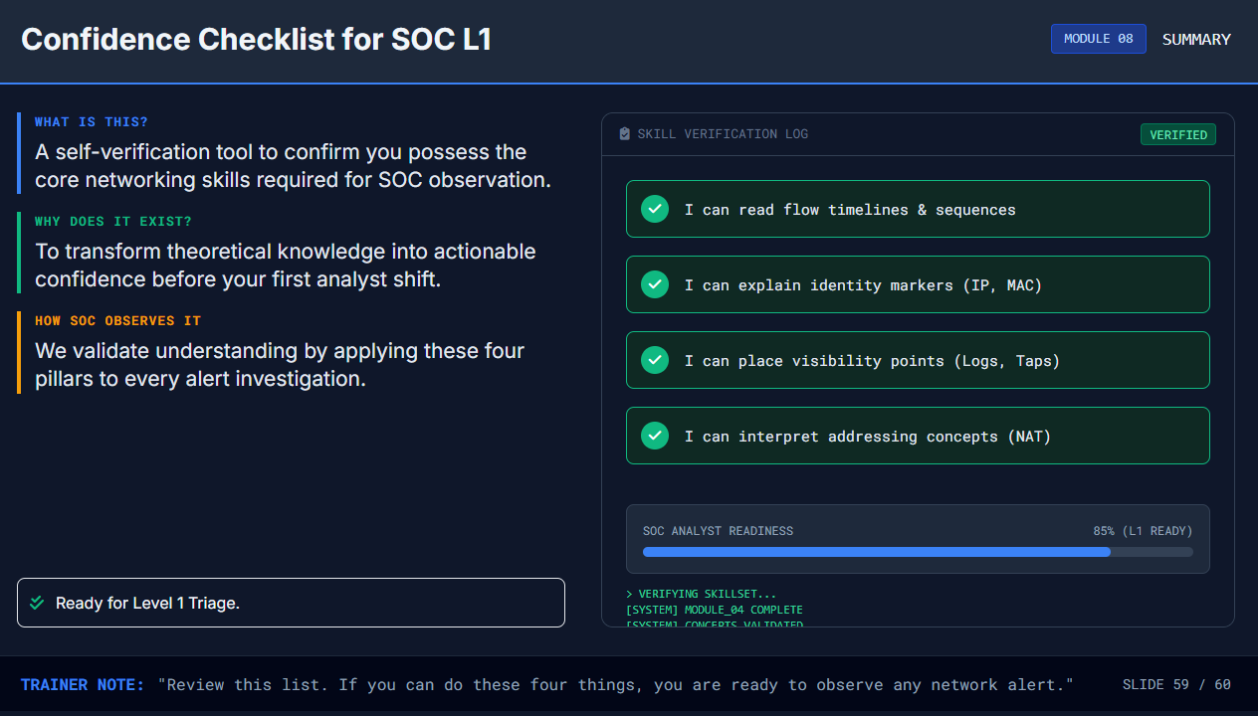

Slide 60





Module Complete: Networking & IP Addressing
MODULE FINISHED
DAY 4
You now understand how network communication works and how SOC observes it.
SKILL ACQUIRED
SKILL ACQUIRED
STATUS
SKILL ACQUIRED
SOC-L1 Ready
Flow Analysis
Identity Tracking
IP Addressing
MODULE COMPLETE:
Congratulations! You have built the foundation for network security monitoring.
SLIDE 60 / 60

